Slide 1

Space and Measurement
Rates of change
Model rectilinear motion
Incremental formula

Slide 2

Rates of Change
In differentiation, finding dy/dx means finding the rate of change of y with respect to x
If other variables are involved, e.g. volume and time, then we use differentiation to find dV/dt, the rate of change of volume with respect to time. E.g. dV/dt = 10 means the volume increases at the rate of
Positive rate: increase, negative rate: decrease
we can find the total change from given rates of change by using integration (antiderivative)

Slide 3
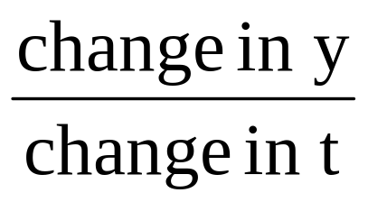

Rates of Change
Average rate of change = rate of change within a given time interval
=
Instantaneous rate of change = dV/dt
= rate of change at a particular moment
= slope/gradient of the tangent line at a point
Over short intervals of time, the average of change is approximately equal to the instantaneous rate of change

Slide 4

Rates of change
Example:
A colony of bacteria is increasing in such a way
that the number of bacteria present after t hours
is given by N where
Find the number of bacteria present initially
Find the number of bacteria present when t=5
Find the average rate of increase in the first 5 hours
Find an expression for the instantaneous rate of change of N with respect to t and hence find the rate the colony is increasing when t = 2
[120, 3870, 750, 620]

Slide 5
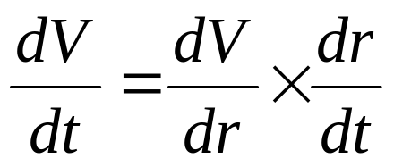
Rates of Change
To solve rate of change problems:
Find a function relating two variables, example V = 2 + 3.2r
Find the derivative, e.g. dV/dr
Find the value of dV/dr by substituting the r-value
Use the formula to find the rate of change for V or r.

Slide 6
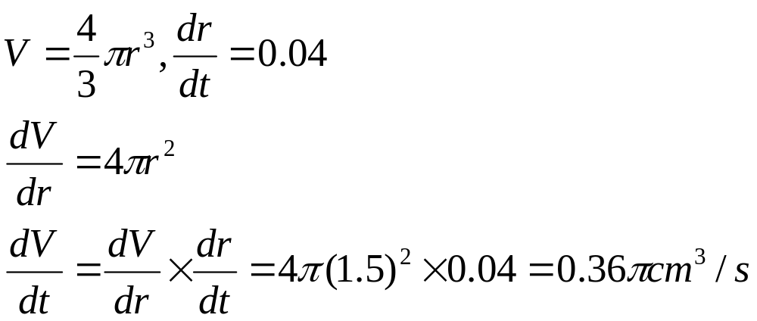
Example of rate of change
A spherical air bubble is formed at the base of a pond.
When the bubble moves to the surface of the water, it
expands. If the radius of the bubble is expanding at the
rate of 0.04cm/s, find the rate at which the volume of
the bubble is increasing when its radius is 1.5cm.

Slide 7
Motion in a straight Line
Involve displacement, velocity and acceleration
One of the commonest rates of change that concerns us is the rate at which we change our location
If displacement, x meters, from a fixed origin O, is a function of time, then dx/dt gives the rate of change of displacement with respect to time i.e. velocity, v
The rate of change of velocity with respect to time dv/dt gives the acceleration, a
Acceleration is also second derivative of x with respect to time

Slide 8
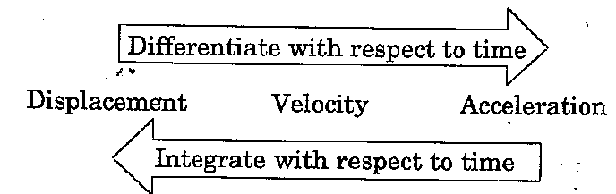
Motion in a straight Line

Slide 9
Motion in a straight Line
Displacement:
to the left of the origin: x < 0
to the right of the origin: x > 0
at the origin: x = 0
Velocity:
movement to the right: v > 0
movement to the left: v < 0
stop or change direction: v = 0
Acceleration:
a > 0: increasing speed
a < 0: decreasing speed
a = 0: constant velocity

Slide 10
Motion in a straight Line
Example:
A particle is initially at an origin O. It is projected
away from O and moves in a straight line such
that its displacement from O, t seconds later is x
metres where x = t(12 – t). Find:
The speed of the initial projection
The distance the particle is from O when t=3 and when t=7
The value of t when the particle change its direction
The distance the particle travels from t=3 to t=7
[12,27,35,6, 10]

Slide 11
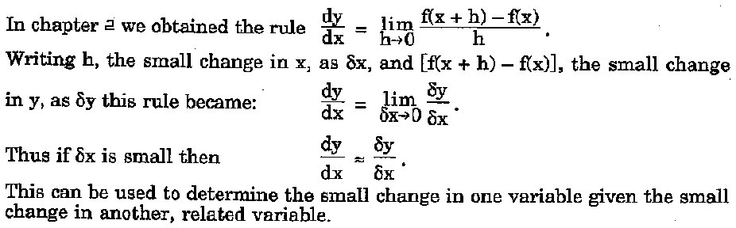
Small change

Slide 12
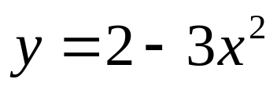
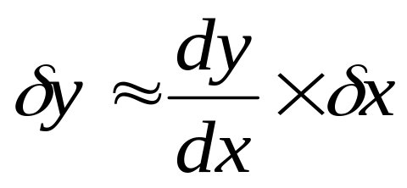
Small Change
To solve problems on small change:
Find a function relating two variables, example:
Find the derivative, e.g. dy/dx
Find the value of dy/dx by substituting the x-value
Use the formula to find the small change for y or x.
Positive value: increase, negative value: decrease

Slide 13
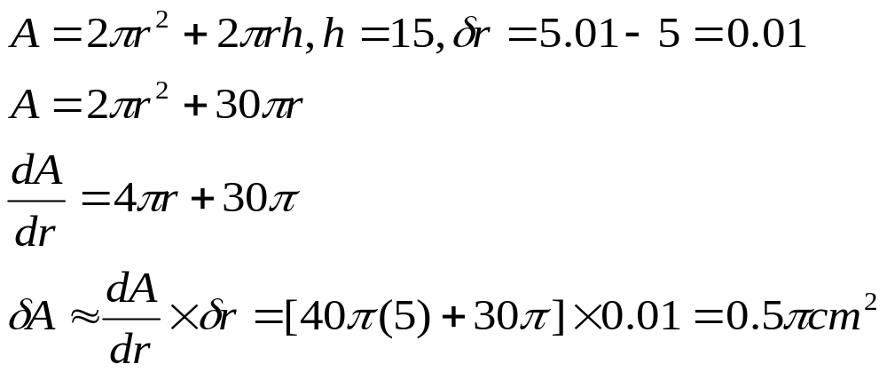
Example on small change
A closed cylinder has a height of 15cm. Find the
approximate increase in the total surface area of
the cylinder when the radius of the cylinder increases
from 5cm to 5.01cm while its height is a constant

